Slide 1
Autonomous Flag Finder
Burnout Squad
Jeremiah McCutcheon: Project Manager
David Koblah: Hardware Design
Michael Bates: Software Design

Slide 2
System Description
This system is an autonomous robot designed to locate, identify and retrieve flags inside a room or maze.
It will utilize a camera and proximity sensors to navigate its environment.
The camera will wirelessly communicate with a computer in order to identify flags and retrieve them.
A microcontroller will control the movement of the tank, proximity sensors and servo motors to rotate the camera or retrieve the flags.
Jeremiah McCutcheon

Slide 3
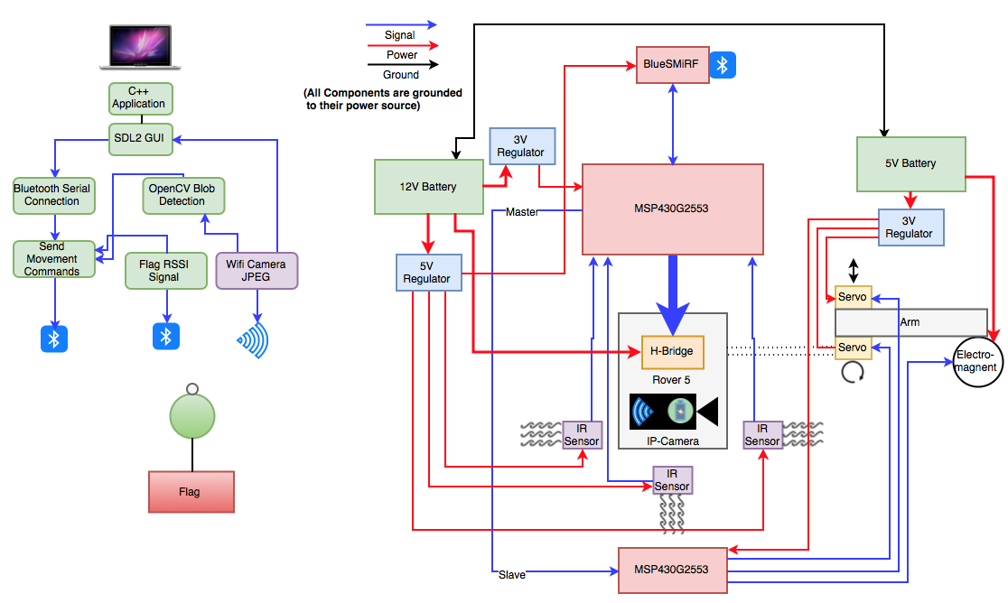
System Diagram
Jeremiah McCutcheon

Slide 4
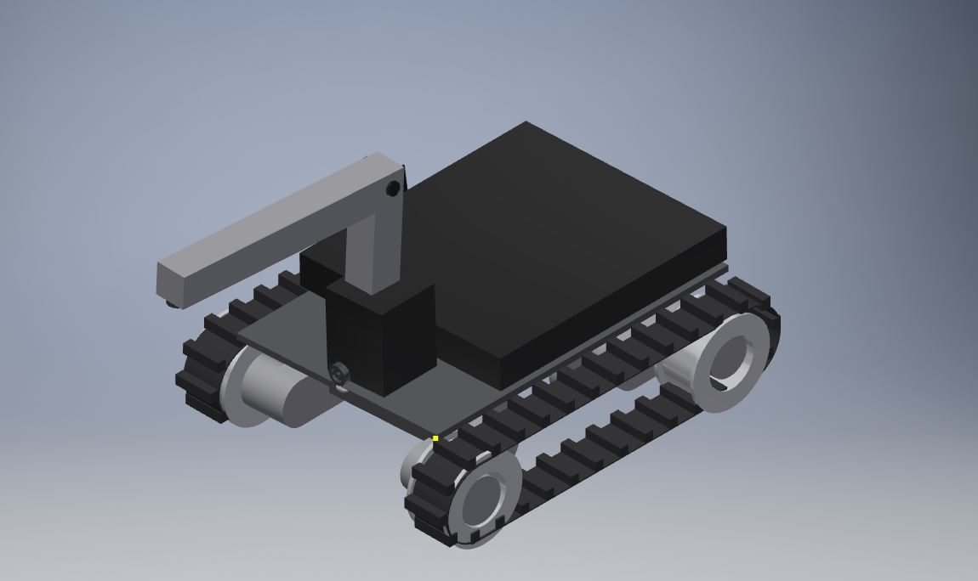
Tank mock-up
Cover for PCB and other circuits
Jeremiah McCutcheon

Slide 5
Division of labor
Jeremiah: Bluetooth Serial Communication Interface with Mac, Video Camera Interface with Mac, Image Processing
David: BlueSMiRF receiving communication, Servo arm and Electromagnet interface, Flag Collection
Michael: Analog IR sensor implementation, Autonomous Navigation, MSP430 Code Interface, PCB, Budget
Jeremiah McCutcheon

Slide 6
Tank Movement & Navigation

Slide 7
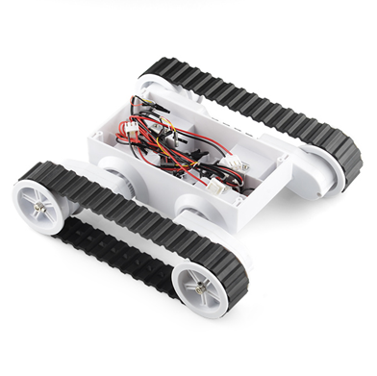
Rover 5 Robot Platform
2 Built-In DC Motors Allowing for Left Side and Right Side Control
Rugged White Plastic Body with Wire and Battery Compartment
Quick Connection wires for H-Bridge
Used in Previous Projects
Michael Bates
Rover 5 Tracked Chassis [1]

Slide 8
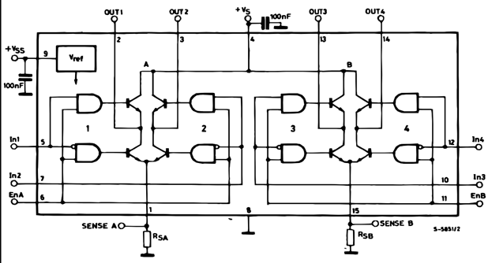
H-Bridge
Controls 2 Motors:
EnA=Left Track
EnB=Right Track
Controls 2 Directions for Each Motor:
In1=Left Forward
In2=Left Reverse
In3=Right Forward
In4=Right Reverse
ST Microelectronics: Dual Full Bridge Driver [2]
Michael Bates

Slide 9
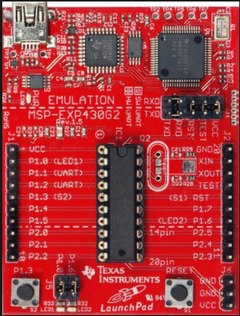
MSP430G2553
Low Cost ($15)
UART Capability
SPI Capability
Removable IC
On Board Programming
9600 Baud Rate
Multiple Timer-A Interrupt Registers
Sufficient Pins
MSP430G2553 Launchpad [3]
Michael Bates

Slide 10
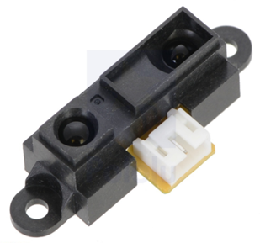
IR
Can Operate on 5V
Distance Measuring Range: 4”-32”
Only Uses 1 Signal Wire
Uses an Analog Signal That Can Be Easily Converted to Digital for Easy to Use Values for Navigation
Pololu IR Sensor [4]
Michael Bates

Slide 11
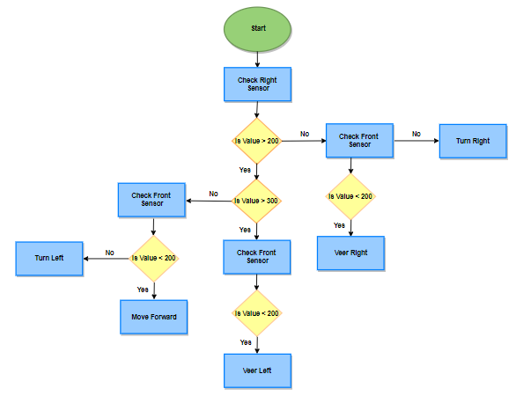
Flow Chart
5 Primary Movements
Forward
Veer Left
Veer Right
Left
Right
Use Timer-A for Movement Duty Cycle
Timer-A0 Controls Left Side
Timer-A1 Controls Right Side
Allows for Veering Movement
Michael Bates

Slide 12
Test Video
Michael Bates

Slide 13
Macbook Interface

Slide 14
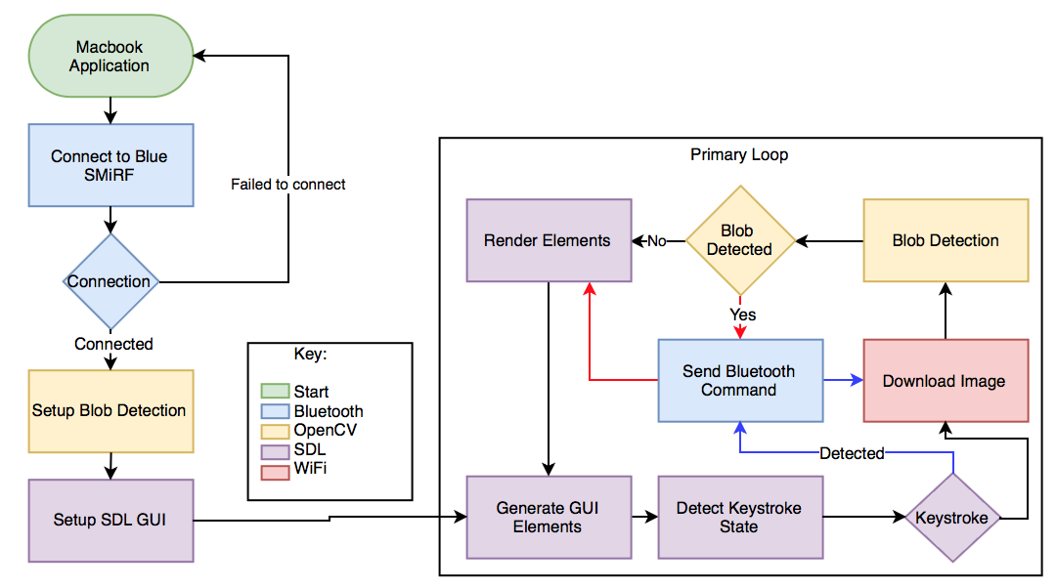
Macbook Application
Jeremiah McCutcheon

Slide 15
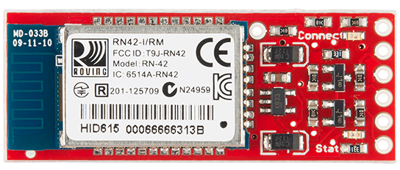
Bluetooth BlueSMiRF
9600 Baud
Controls rover in manual mode and during blob detection
Jeremiah McCutcheon
SparkFun [5]

Slide 16
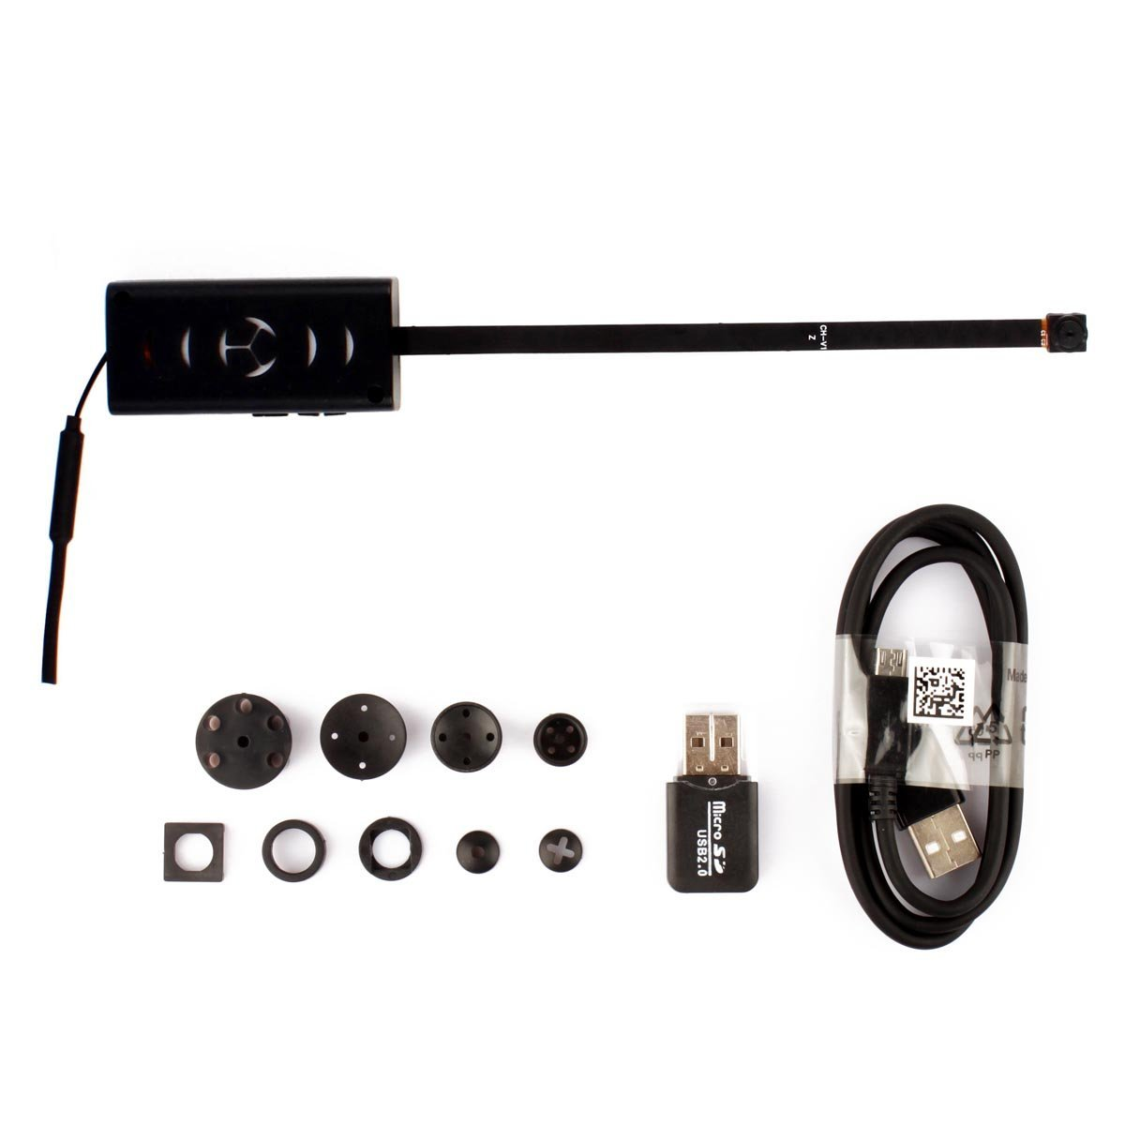
WiFi Camera
App downloads images from the IP camera
Images are analysed by OpenCV
Camera Mount
Jeremiah McCutcheon
Amazon: Magendara WiFi Camera [6]

Slide 17
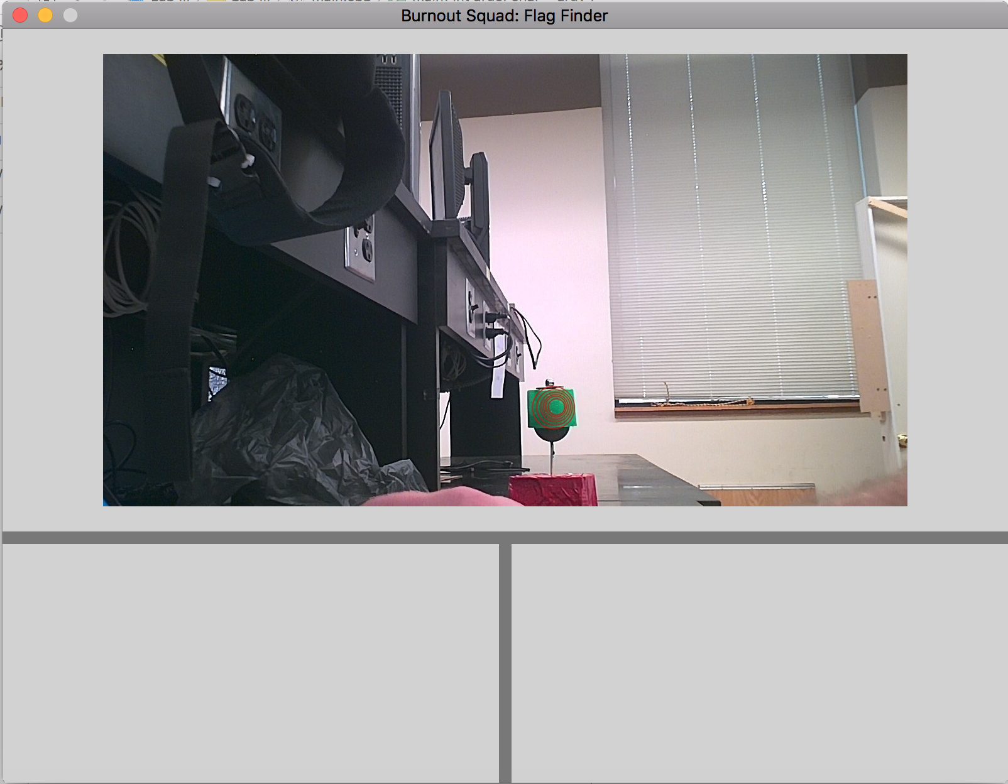
SDL: Simple DirectMedia Layer
Made for game creation
Renders GUI elements
Incomplete GUI
Jeremiah McCutcheon

Slide 18
Keystroke Movement Control
Reads the state of the keyboard
Sends Bluetooth commands for keys pressed
Jeremiah McCutcheon
SDL Wiki: Keystate [7]

Slide 19
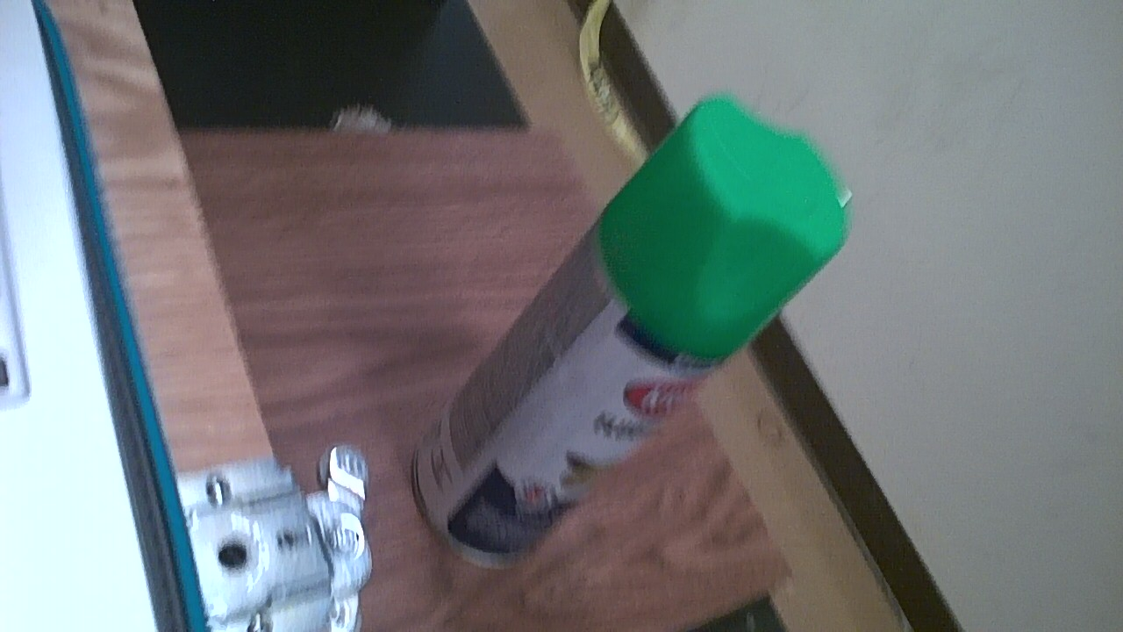
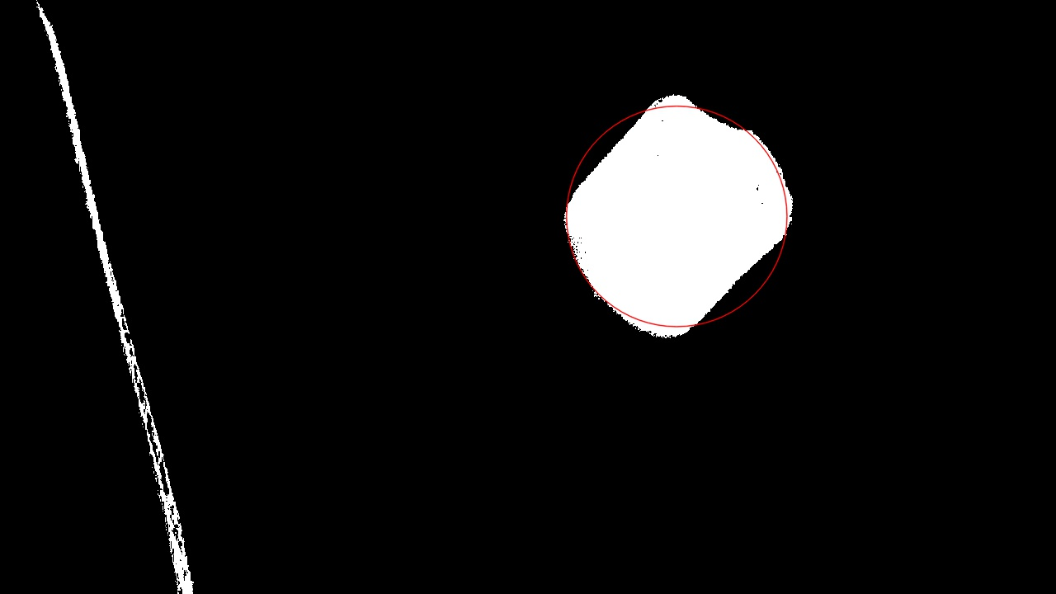
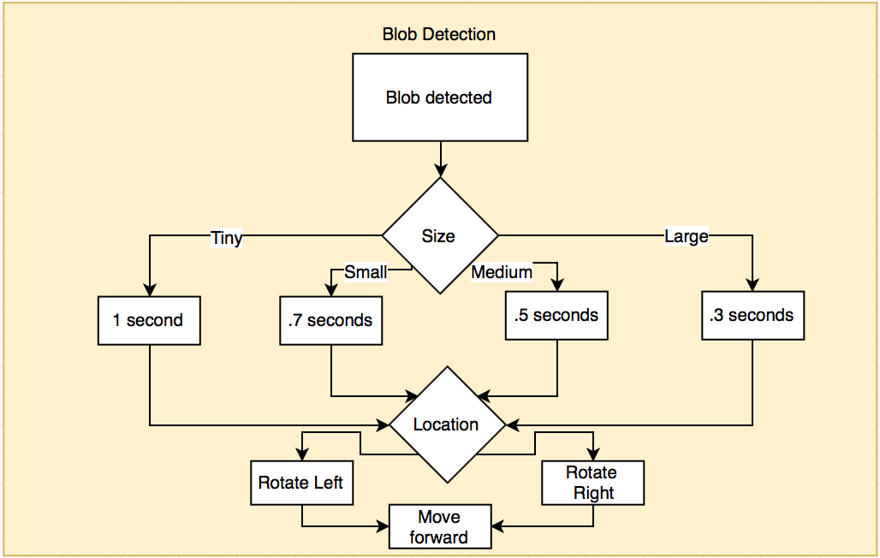
OpenCV Blob Detection
The image is masked for green
The program reads the blob size and location
Movement commands are sent via bluetooth
The flag is retrieved when in range
Jeremiah McCutcheon

Slide 20
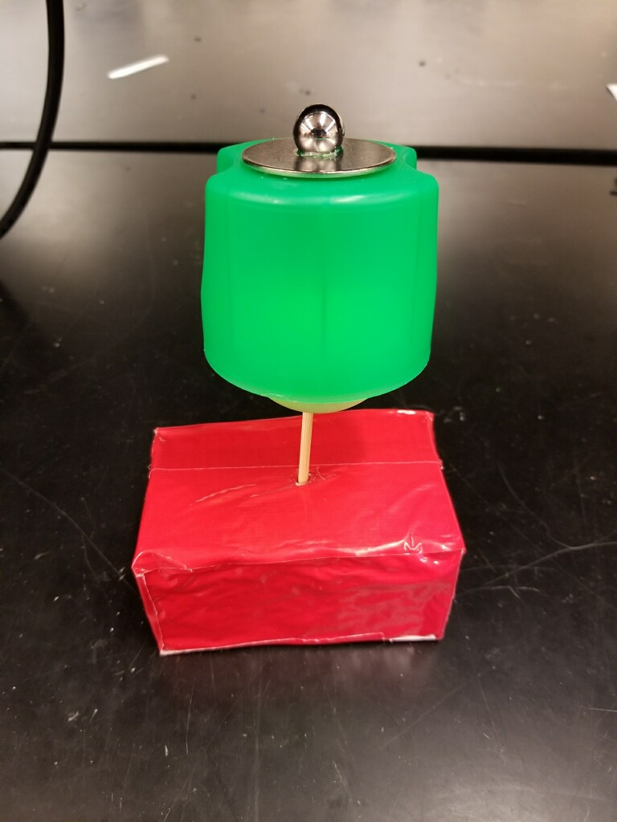
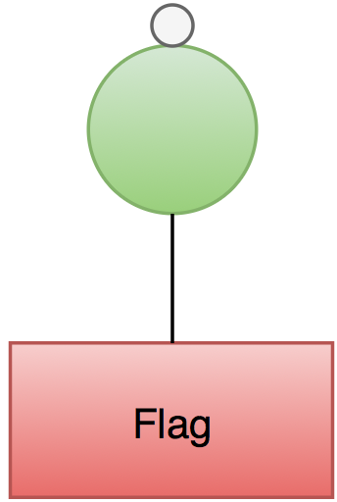
Flag design
Jeremiah McCutcheon

Slide 21
Flag Seeker Videos

Slide 22
Flag Retrieval

Slide 23
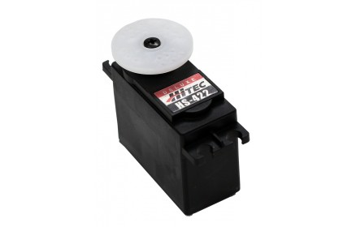
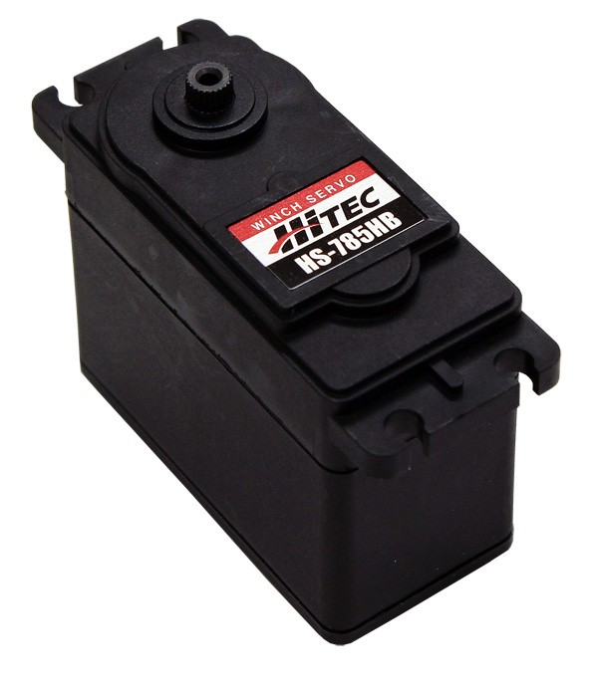
Servo Arm Components
HS-785HB
HS-422
Voltage Range: 4.8V-6.0V Voltage Range: 4.8V-6.0V
Max. Current Drain: 285mA Max. Current Drain: 180mA
Max . PWM Range: 600-2400µs Max . PWM Range: 1000-2000µs
Servo City [8]
David Koblah

Slide 24
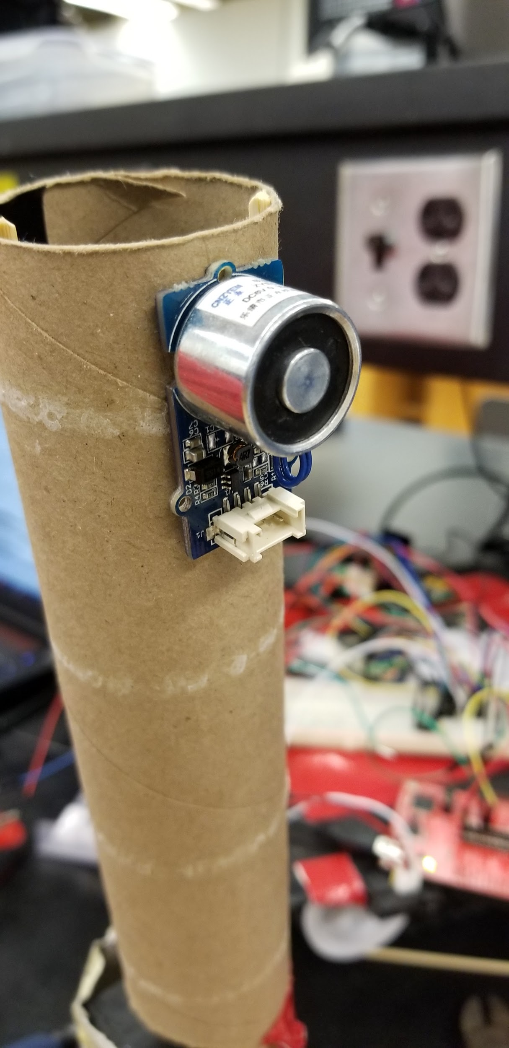
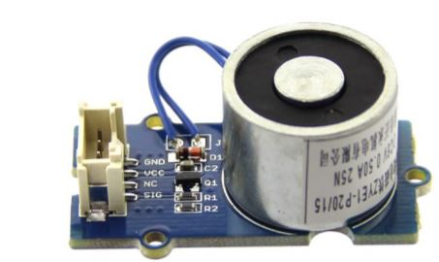
Electromagnet
Requires signal to activate magnet. Only activated when required for flags
Working Voltage : 5V Standby Current: 200µA
Working Current: 400mA Load Weight: 1kg
Mouser.com [9]
David Koblah

Slide 25
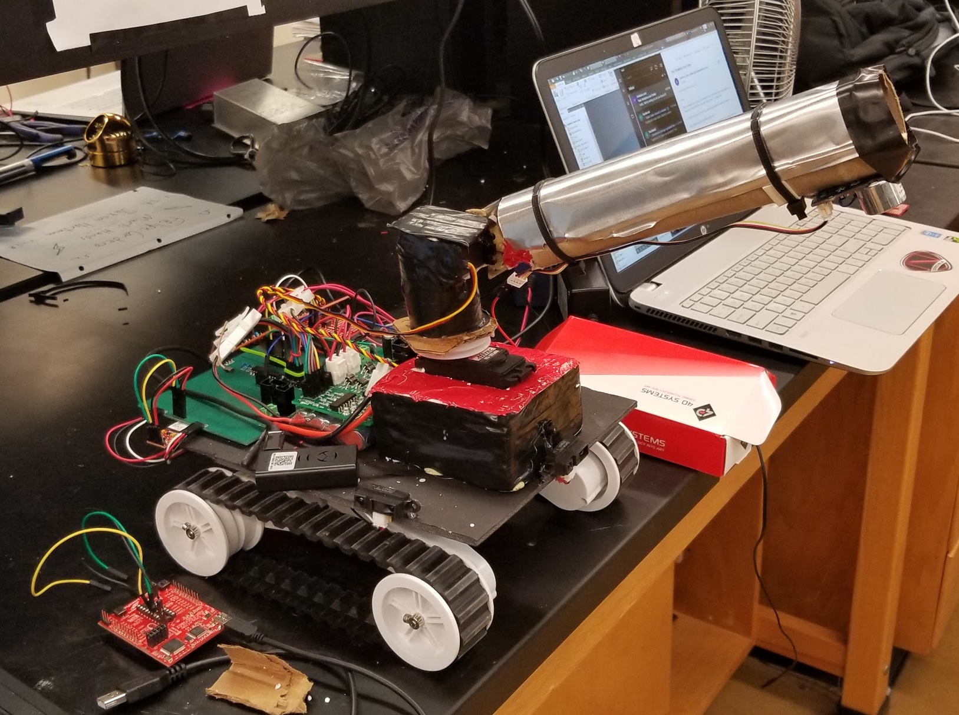
Completed Rover (“Under The Hood”)
Maximum Length (Arm at Full Length:
402 mm
Maximum Width:
225 mm
David Koblah

Slide 26
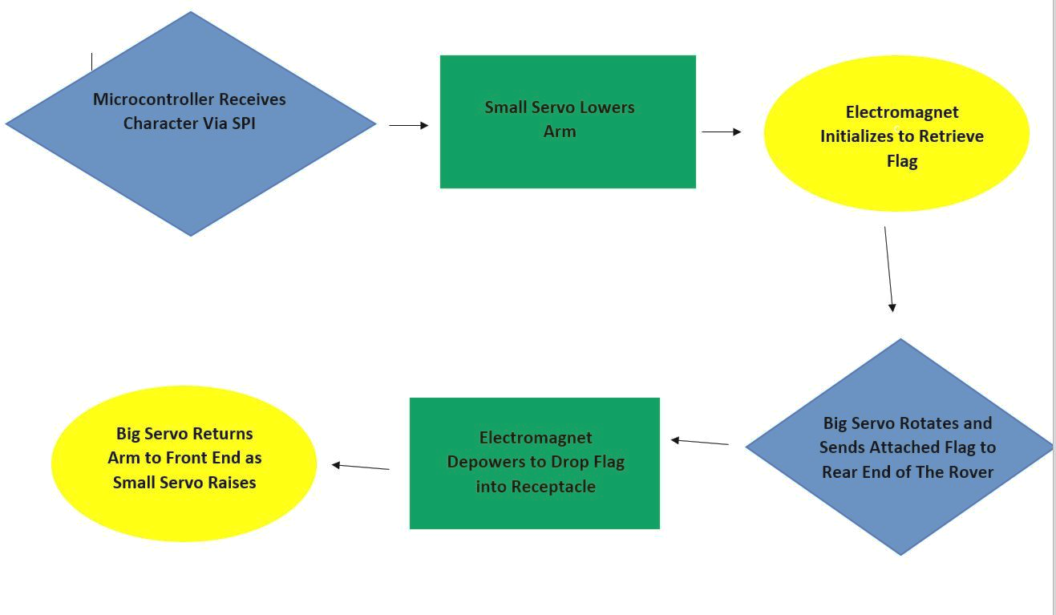
Robot Arm Sequence
David Koblah

Slide 27
Weight of Robot
Main components:
Robot Arm (201g) + 2 2000mAh Batteries (70g)+
Rover Chassis (1179.34g) + Camera (22.68g) +
Circuit components, Wiring, Sensors & Miscellaneous (50g)
Estimated Total Weight= 1523.02g = 3.357lb
David Koblah

Slide 28
Power Estimates
Power Sources Available:
9.6V, 2000mAh Battery x2 : 2 x (2A x 9.6V) = 38.4W
Battery Pack for Robot Arm: 5V x 2.4A = 12W
Inbuilt Camera Lithium Polymer Battery: 3.7V x 0.48A = 1.78W
Total Power Available = 52.18W
Estimated Power Consumed = Motors (12.96W) + Camera(1.78W) + Robot Arm(4.325W) + PCB & Sensors(6W) = 25W
Ideal Runtime of Rover With Load =2000mAh/1800mA= 67 mins
David Koblah

Slide 29
Safety Concerns
Our primary safety concerns dealt with managing the 9.6V battery to avoid any fires and over volting microcontroller circuits.
Making sure not to connect to TTU with lab router. Because our devices would violate security protocols.
Wearing appropriate Personal Protective Equipment
Pants
Closed Toed Shoes
Safety Glasses
Making sure to perform all painting OFF campus.
David Koblah

Slide 30
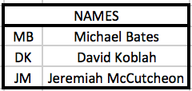
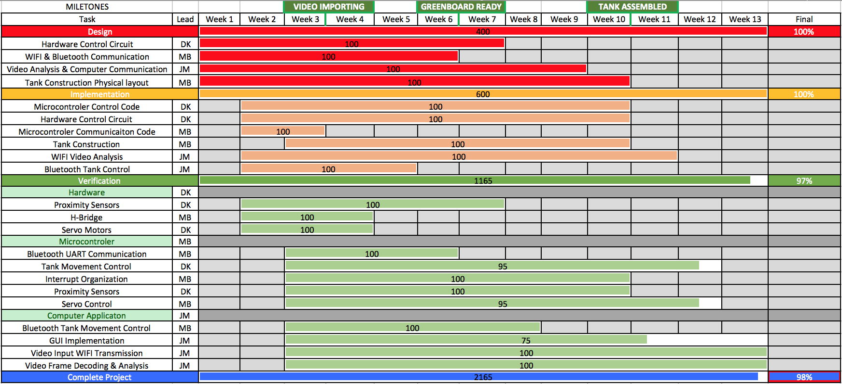
Gantt Chart
Jeremiah McCutcheon

Slide 31
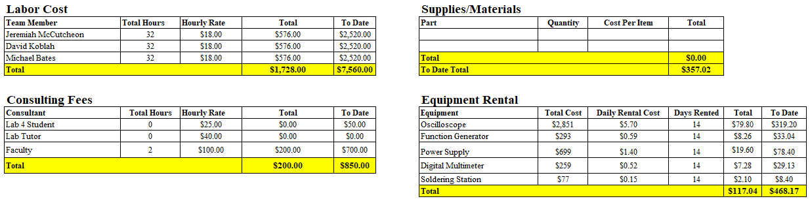
Budget
Michael Bates

Slide 32
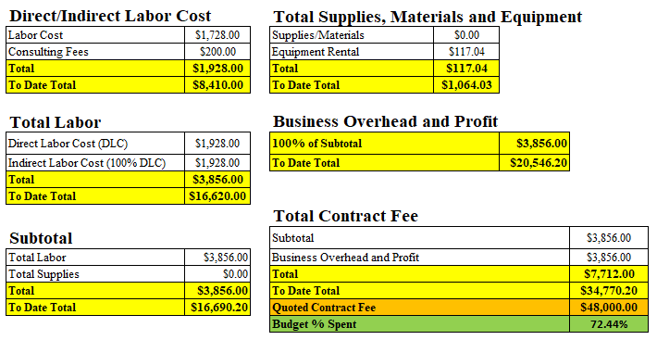
Budget Continued
Michael Bates

Slide 33
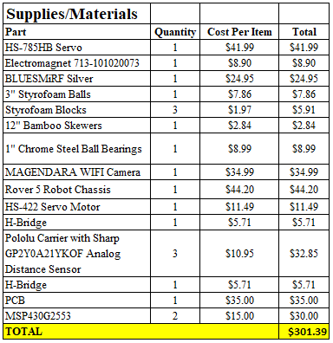
Final Parts List
Michael Bates

Slide 34
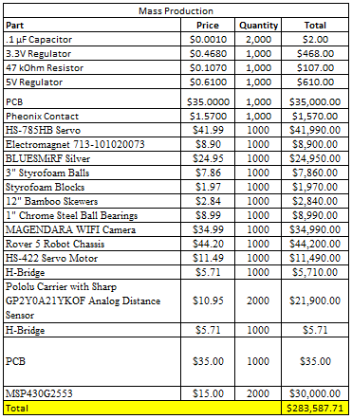
Mass Production (1000) Cost
Sell each for $425.38 to make 50% profit ($425,382.57).
Michael Bates

Slide 35
References
[1] Sparkfun Rover 5 Robot Platform, https://www.sparkfun.com/products/10336
[2] ST Microelectronics H-Bridge dual motor controller : http://www.st.com/en/motor-drivers/l298.html
[3] Texas Instruments User’s Guide, MSP430G2553 Launchpad Development Kit, http://www.ti.com/tool/MSP-EXP430G2
[4] Pololu, Sharp GP2Y0A21YK0F Analog Distance Sensor 10-80cm, https://www.pololu.com/product/136
[5] SparkFun BlueSMiRF Silver: https://cdn.sparkfun.com/datasheets/Wireless/Bluetooth/Bluetooth-RN-42-DS.pdf
Michael Bates

Slide 36
References Continued
[6] Amazon- https://www.amazon.com/Tenergy-Standard-Connector-Security-Rechargeable/dp/B001BA292A
[7] SDL wiki: SDL keystate: https://wiki.libsdl.org/SDL_GetKeyboardState
[8]Mouser.com https://www.mouser.com/ds/2/744/Seeed_101020073-1217554.pdf
[9] Servo City https://www.servocity.com/
Michael Bates

Slide 37
Questions?

